Slide 1
Stock Trading Bot
Project Number #37
Team Members: Beaman Negash, Joseph Barr, David Valverde, Avery Turnbull, Adideb Nag
Advisor(s): Narayan Mandayam

Slide 2
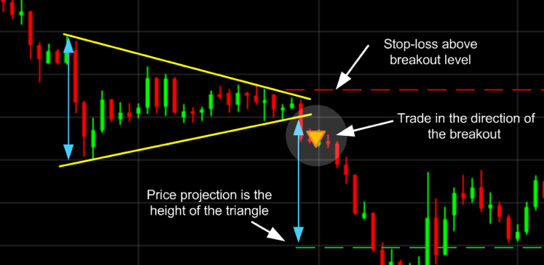
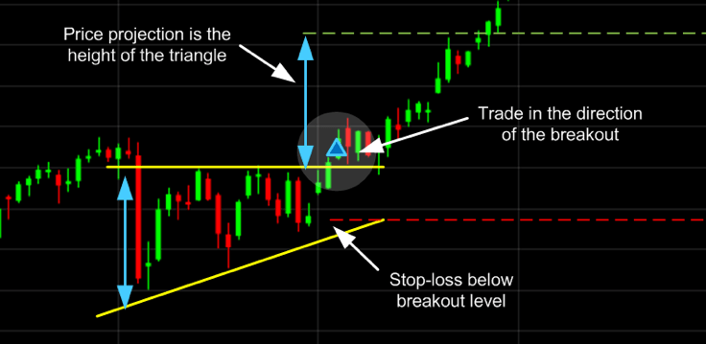
Background Information
People aren’t good at investing in the stock market
Emotions and too much data confuses people
Success rate for retail traders is an average of net +10%
Stock market trends follow patterns over its lifetime
Data shows patterns over different sectors and stocks
Shapes within the price predict future behaviour
Patterns to be followed are hard to recognize for humans
Tracking different values such as SMA, EMA, and RSI
Can do so accurately with help of different python libraries
14:332:448 - Spring 23

Slide 3
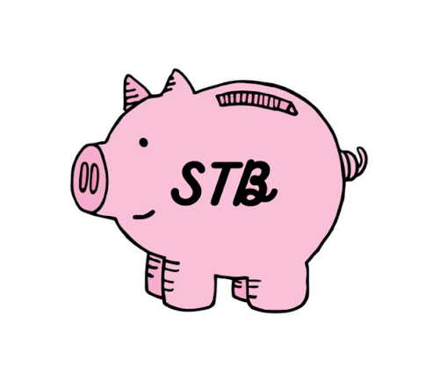
Proposed Solution
Stock Trading Bot
The Stock Trading Bot (STB) is an algorithm controlled bot that will implement industry wide standards to maximize our users’ profits
STB will purchase stocks based on users’ interests and automatically sell these stocks when they reach a certain percent profit
STB will let users establish a predefined stop loss and have an exact quantitative measure of the risk being taken in a particular trade
A bot limits the problems that come along with human investing
Lack of knowledge, treating the stock market like a casino, being impatient, and being emotional
14:332:448 - Spring 23

Slide 4
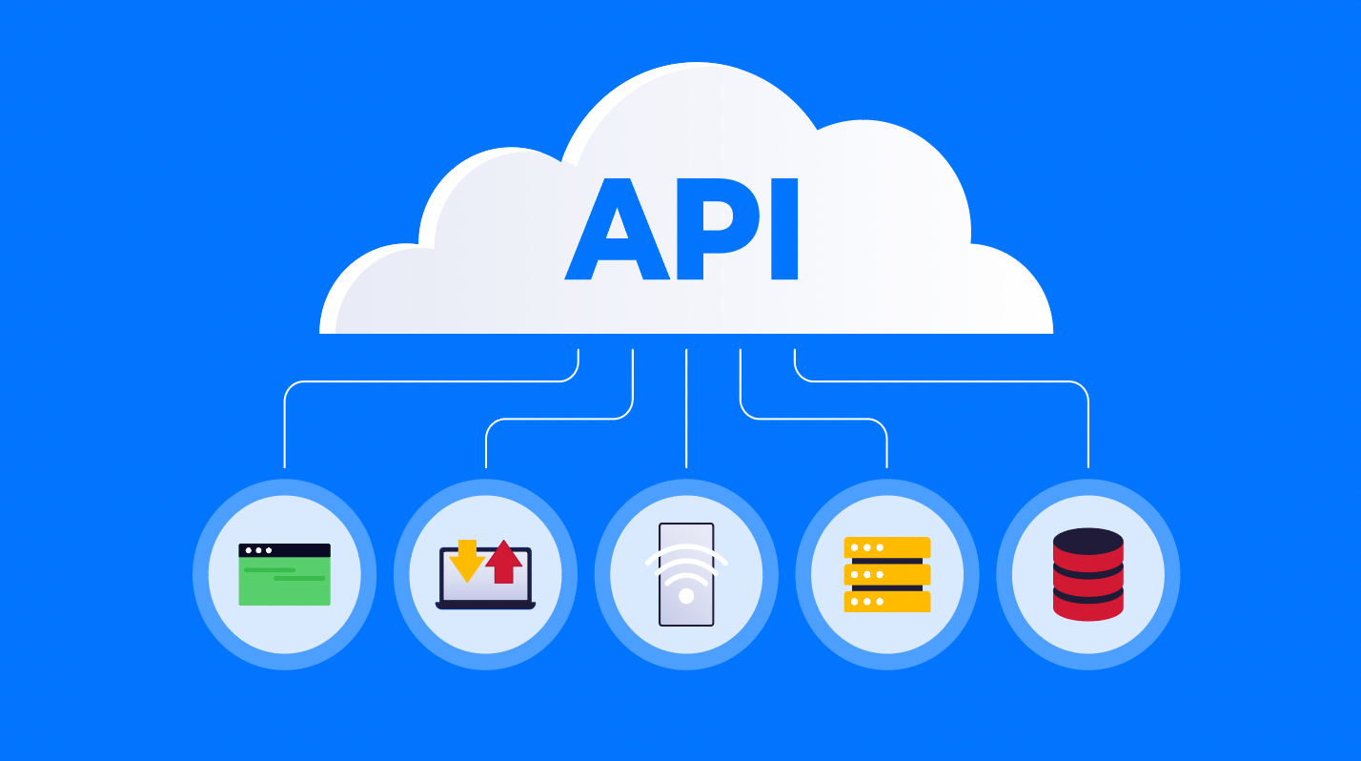

Scope of Work & Conceptual Design
Use Market APIs
Application Programming Interface
Set of definitions and protocols for building and integrating application software
Sign up to Alpaca markets account
API for Stock Trading (Real and Paper Money)
Trade with algorithms, connect with apps, and build services with easy to use API
Lumibot Library
Library that allows backtesting of trading strategies
Create bots that are profitable in different asset classes such as Stocks, Options, Futures, FOREX, and more
14:332:448 - Spring 23

Slide 5
General Work Plan (Waterfall Method)
Now - Winter Break Ends: Learn more about the stock market/trading, review/learn Python, and watch tutorials pertaining to algorithmic trading ✔️
Jan- mid-February: Develop software architectural models, documentation, and requirements for our system while also building an interactive GUI ✔️
Mid-Feb-March: Begin developing our system within Python and other APIs mentioned previously ✔️
March-April: Test our system and make changes to them best seen fit (Current)
14:332:448 - Spring 23

Slide 6
Task Allocations
Beaman Negash - Primary Coder/ Initial design/historical data review
Joseph Barr - Primary Coder/ rework/ approach and execution of Interfacing
David Valverde - Algorithm requirements/ software modeling/ design structure/ stock market analysis
Avery Turnbull - Algorithm requirements/ stock market analysis/ approach and execution of Interfacing/design structure
Adideb Nag - Coding/ Approach and execution of Interfacing/ initial design/rework
14:332:448 - Spring 23

Slide 7

Project Progress
Collecting reference data that will be accessed by trading algorithm
Further understanding of the stock markets inner workings
Favorable trends
Buying/selling points
Stocks vs Index Funds
Understand Market Terms
Bull Markets vs Bear Market
Bull = Securities rise by 20% or more
Bear = Securities fall by 20% or more
Market crash vs correction
Crash: sudden very sharp drop in stock prices (Covid 2020)
Correction:Stock market drops by 10% or more
14:332:448 - Spring 23

Slide 8
Milestones
Conduct research on algorithm ✔️
Conduct research on stock market trading practices ✔️
Design first implementation of algorithm✔️
Finalize algorithm ✔️
Successfully implement algorithm into bot ✔️
Connect bot to open market to begin trading ✔️
Execute first trade ✔️
Make profit using fully automated bot (Current Progress)
Maintain a profitable portfolio for at least 5 full business days with continued trading (Current Progress)
14:332:448 - Spring 23

Slide 9

Demo
14:332:448 - Spring 23

Slide 10



Project Implementation
Python Algorithm:
Algorithm first boots up, trying to create connection to Alpaca API
Once connection is established, trade requests are sent to Alpaca API to be executed in Stock Market
Refreshes every 10 seconds to see if previous price is below current price
Alpaca API
Allows communication between Algorithm and Stock Market
Acts as Stock Brokerage account, visualizing account balance while showing stock executions being filled
Stock Market
Receives communication from Alpaca API on what stocks are to be bought/sold
Relays stock information back to Alpaca API if stock was bought/sold
14:332:448 - Spring 23

Slide 11
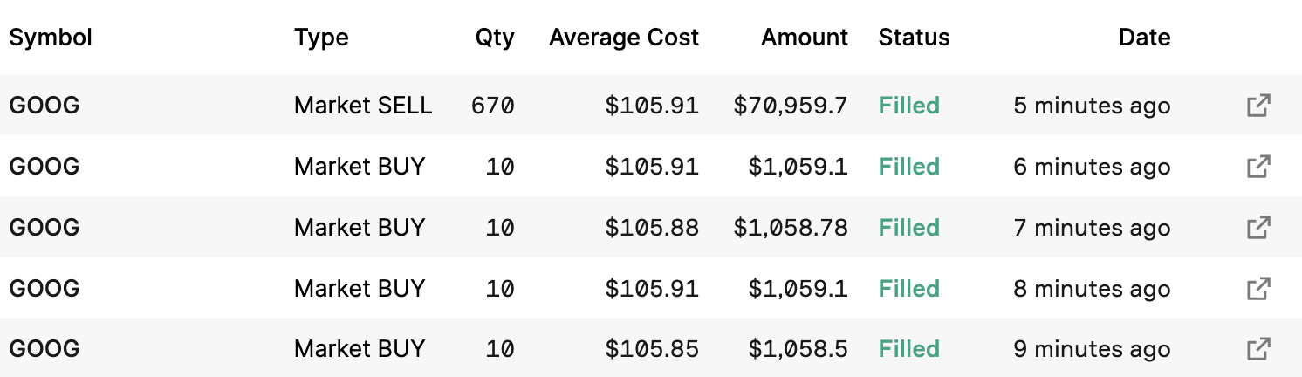
Performance
Calibration
Currently our algorithm isn’t fine tuned, as it has a quite negative outlook on the market
Algorithm likes to hold rather than sell
Fix this by changing parameters with “confidence”
Entry Points are admissible but can be improved
You can never time the market, but having our algorithm enter trades at better prices will improve functionality/profits in the long run
Profit Taking
No Profit Taking set in place yet
No matter balance, algorithm sells before end of market closure
14:332:448 - Spring 23

Slide 12
Challenges
Lack of Machine Learning
Without the use of Machine Learning, we will have to hard code the algorithm which will be time consuming
Stock Market understanding
As engineers, we don't have an education in the stock market. Our understanding of the Stock Market has been a learning curve
Market Data
Determining what specific historical market data for stocks to analyze and perfect our algorithm without overwhelming our selves by using to much data.
User risk
Determining how to address the risks of the user potentially losing money and how to minimize it.
Paper Money
Have to trade with paper money due to stock market balance restrictions
14:332:448 - Spring 23

Slide 13

Prototype costs, project expenses and estimated cost of mass production
Prototype costs/Project expenses:
As this project is entirely code based, there were no direct Prototype costs. In theory, costs would include:
Computer
Power
Internet
In addition, since we are trading with paper money, there were no costs
Estimated cost of mass production:
In accordance with Day Trading Rules by the SEC, an user must have $25,000 in their account in order to day trade.
As such, the estimated cost of mass production would be:
Cost = Number of bots * $25,000
14:332:448 - Spring 23

Slide 14
Project Potential Impact - Positives
Healthier More Inclusive Market
These tools are usually only accessible to major financial institutions, but now virtually anyone can start getting involved.
This allows for the levelling of the playing field between those in economic disparity.
Greater Liquidity can lead to more Institutional Interest
Liquidity means having sufficient buyers and sellers so that traders can have faith that they can make a trade when and where they need to.
An important source of liquidity is Market Makers, who are entities that place both buy and sell offers across the bid-ask spread, making their profit from the difference
When this strategy is done in high frequency fashion using algorithms, it can increase profits for party using it but also boost liquidity
14:332:448 - Spring 23

Slide 15
Project Potential Impact - Negatives
Pump and Dump scams can become more prevalent
Using bots, scammers make it look like a security is beginning a bull run. When regular traders see this, they join in with the hopes of making profit
Once a security has risen to a certain profit level for the scammers, the bots sell everything causing the security to collapse
The bull run was never real as is was built by hype and market manipulation.
Institutions can get unfair advantages
Many institutional players leverage the power of automated trading with the use of Colocation
Colocation is a service offered by firms that allow businesses to rent/host servers at the same site as exchange with direct connections to trading systems
Clients have fastest ability to post orders, completely beating those without the service
14:332:448 - Spring 23

Slide 16
Q+A
14:332:448 - Spring 23

